Slide 1
CODAPPS – last IBM Hall session
A presentation of programming languages
for beginners.
Clément Levallois. 17 November 2016

Slide 2
CAVEAT
The following slides contain many simplifications, for the sake of brevity.

Slide 3
em lyon business school course offering (2016)
C# and C++ classes in finance
VBA classes (programming in Excel)
Java (CODAPPS: coding mobile apps)
Python (1 open course and multiple courses in data science)
Javascript (creating web apps from scratch)

Slide 4

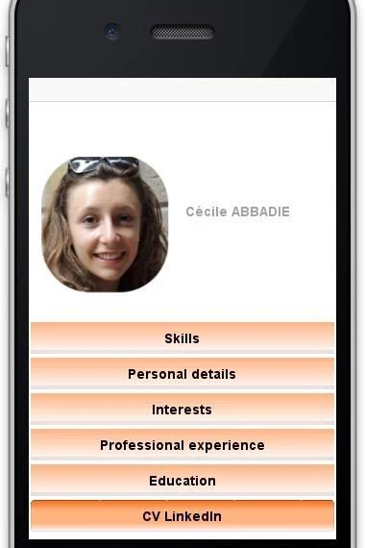
Hamilton standing next to the navigation software that she and her MIT team produced for the Apollo project.
https://en.wikipedia.org/wiki/Margaret_Hamilton_(scientist)
Cécile Abbadie, em lyon business school student, promo 2016:
https://play.google.com/store/apps/details?id=io.codapps.cecile&hl=en

Slide 5


Desktops vs servers
Notes:
Dekstop:
Software to manage the video, the interface (opening and closing windows), the keyboard, mouse, dvd and blue ray readers and burners, sound, access to the memory stick, etc… and all the applications a user might need: Excel, word, email, games, …
Servers:
More boring stuff like: storing the data about all customers. Being able to create a train ticket reservation and send the tickets. Managing the security of who can access to what. Managing backups.

Slide 6
Programming on desktops or servers: same methods
Variables
Functions (methods…)
If then else…
Loops…

Slide 7
C (1972!): mother of many languages.
The fastest. The hardest to code. Can run everywhere in principle.
C++ (1980)
As fast as C but easier to code.
-> C and C++ have been used to create the fundamental software which run the computers you use: Mac OS, Windows, Linux.
Course by em lyon business school
“C++ programming”

Slide 8

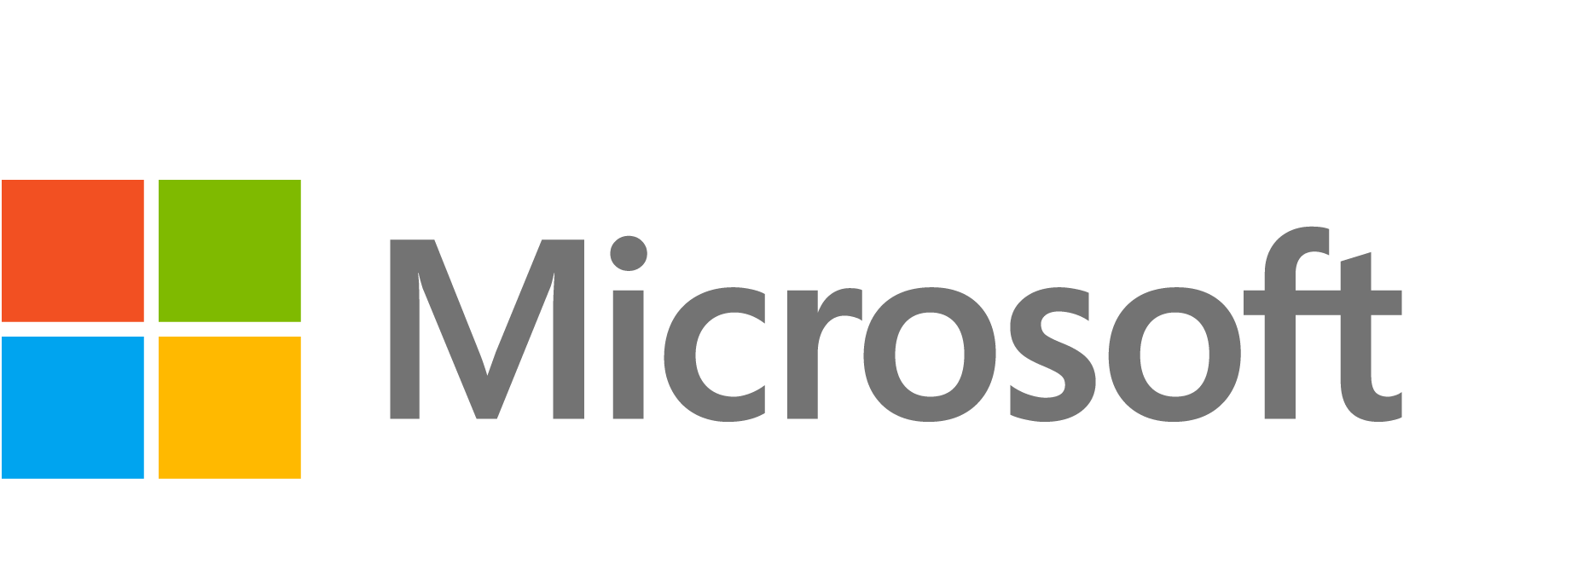
Apple: the “Objective C” programming language (1986)
To create software running on Mac OS.
Only for Apple computers, not servers
Objective C evolved to Swift in 2015
Microsoft: the “.NET” framework: encompassing languages such as VBA (1991) and C# (2001).
To create software running on Windows.
Course by em lyon business school
“C# programming”

Slide 9
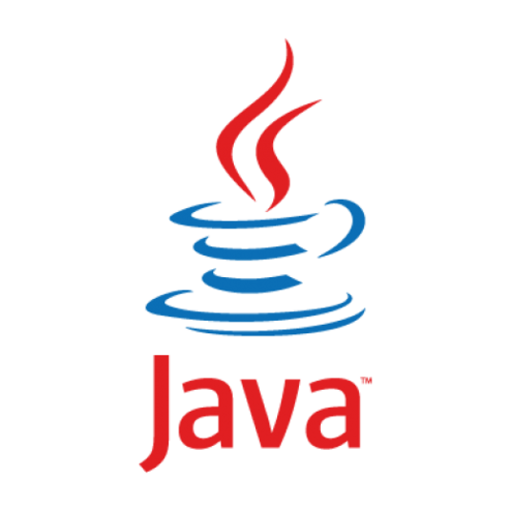
The case of Java (1995)
“Write once, run everywhere”
-> a programming language to create software running on Mac, Linux, and Windows, both on desktops and servers.
The most popular language to build professional applications running on servers (banks, airlines, any big org).
Owned by Oracle.

Slide 10
So far…
Use Swift for Apple desktop software. Does not run on servers.
Use C# or VBA or VB.net or ASP.net to build Windows desktop software or programs running on Microsoft servers
Use Java to build software that works cross-platform (Mac, Windows, Linux), on desktops and servers
Use C or C++ if you need ultra efficient software (games, video treatment, or things that need the least memory possible…)

Slide 11
BUT… INTERNET ?????
A web page is always an HTML document!
HTML: used to create and organize a web page (text, line breaks, tables…)
Not really a programming language, more like the way to write a web page.
CSS: used to add some design the web page (color, margins, font size…)
Not really a programming language, more like the way to design a web page.
Javascript: used to add functions to a web pages (graphics, movement, buttons, …)
So, javascript is a programming language which works in a web browser, to control what happens on web pages!
PHP: used to manage the server side of web pages (so, PHP runs on the server).
To connect the web page to a database on a server, to do calculations on the server, to manage security, etc.
php: most popular in its category!

Slide 12


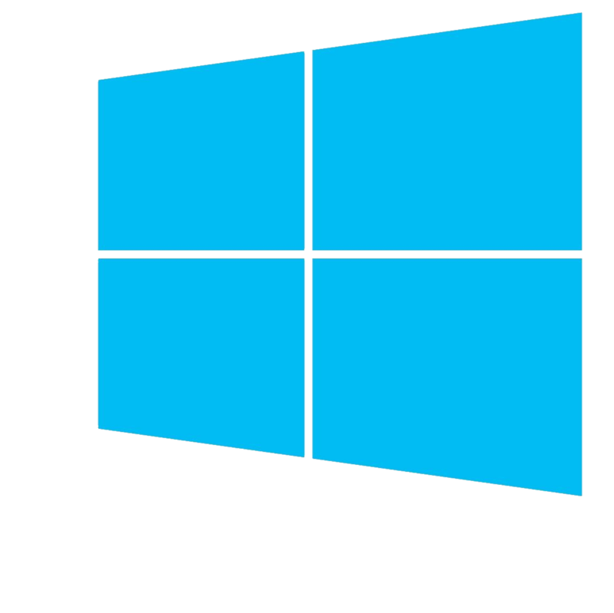
BUT… MOBILE PHONES AND MOBILE APPS?????
Apple: uses Objective C or SWIFT to create apps for iPhones
Google: uses a version of Java to create apps for Android phones
Microsoft: uses C# to create mobile apps for Windows Phones

Slide 13
So far…
FRAGMENTATION
We need to know many programming languages!

Slide 14
A solution: translations!
Code in one language, then “translate” in the languages you need
Course by em lyon business school
CODAPPS
This is what we do in CODAPPS:
Create the project of an app in JAVA. Can’t run on mobile phones yet!
Send this JAVA project to Codename One.
On their servers, the developers at Codename One have created a software which automatically translates our JAVA project into Android (for Android phones), Swift (for iOS phones) and C# (for Windows phones). Done!
This solution saves time, and money, and complexity.
But the “translation” process raises two issues. 1) is the translation perfect? 2) with programming languages evolving so fast, can the translating mechanism be maintained at a reasonable cost?

Slide 15
A second solution: use one language across all devices!
Javascript:
eating the world!

Slide 16
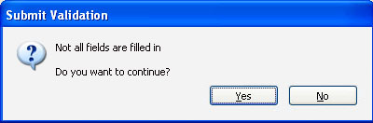
Javascript in 1995!
In 1995: Javascript is just a small programming language for web browsers to create simple things like alerts on web pages
… since 2009: Javascript can be used on the server! It is called Nodejs.
in replacement of the PHP programming language for example
… since ~ 2013: Javascript can be used to create mobile apps!
check this name: “IONIC”
Course by em lyon business school
on nodejs:
“Web Startup Toolkit”
(so, why don’t we use IONIC to build apps in CODAPPS? Because the tools to use IONIC are very hard to install, we would spend the semester on it. Want to try? http://ionicframework.com/getting-started/)

Slide 17
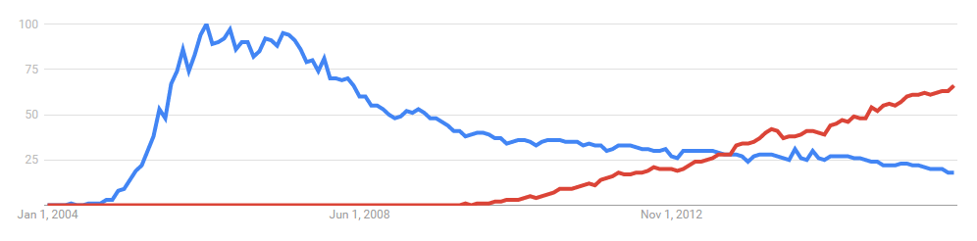
I also heard about Python, Ruby and R… ?
Ruby / Ruby on Rails: a server side language to build web apps, like PHP. Less popular since nodejs appeared.
nodejs
ruby
Source: Google Trends
Python and R:
2 programming languages popular to do “data science” (statistics, machine learning, text mining, network analysis, etc.)
R is really specialized in data science / statistics, can’t do much else.
Python is more versatile. It is becoming very widely used, by academic researchers and businesses. We teach it at em lyon because we think it is a useful skill for future managers.
Course by em lyon business school
“Python bootcamp”
+ 5 courses in data science for business using python

Slide 18
And many more!
Many languages have variants (“the simplified version of…”, “the better version of…”)
Many languages are popular in small communities, or are still very young!
Many languages have almost died but are still practiced by some enthusiasts
To continue the conversion or ask for advice, don’t hesitate to stay in touch
Clément Levallois – levallois@em-lyon.com
(or preferably on Twitter: @seinecle)

